Slide 1

ADVANCED PROGRAMMING LANGUAGE
KOTLIN PROJECT DEMO
Overview of the App, Features, and Future Directions

Slide 2

TEAM MEMBERS
KOTLIN Project
SAI CHARAN CHOWDARY KOMMI
DARSHIL PATEL
SAI ROSHAN REDDY PASULA
ABHINAY SAI KANCHARLA
AARYAN SANYASI MUDADI

Slide 3

Technologies Used
Kotlin
A modern, statically typed programming language used for Android development. It’s fully interoperable with Java and offers enhanced readability and fewer lines of code.
Firebase
Firebase is a backend-as-a-service platform by Google providing real-time databases, authentication, cloud storage, and other tools to simplify development.

Slide 4

Why Firebase
Firebase Features Used:
Authentication: Secure sign-in using email/password, with easy integration.
Cloud Firestore: Real-time database for storing and syncing task data.
Cloud Storage: Storing user-generated data, such as images or attachments for tasks.
Push Notifications: Notification service to alert users about task reminders.

Slide 5

Features Included
Login: Secure authentication to access the app.
Register: User registration with email and password.
Forgot Password: A simple recovery option for password reset.
Add Task: Option to add a new task with details.
Edit Task: Users can modify task details.
Delete Task: Deleting completed or unnecessary tasks.
Complete Task: Mark tasks as completed.
Account Information: View and update user profile and details.

Slide 6
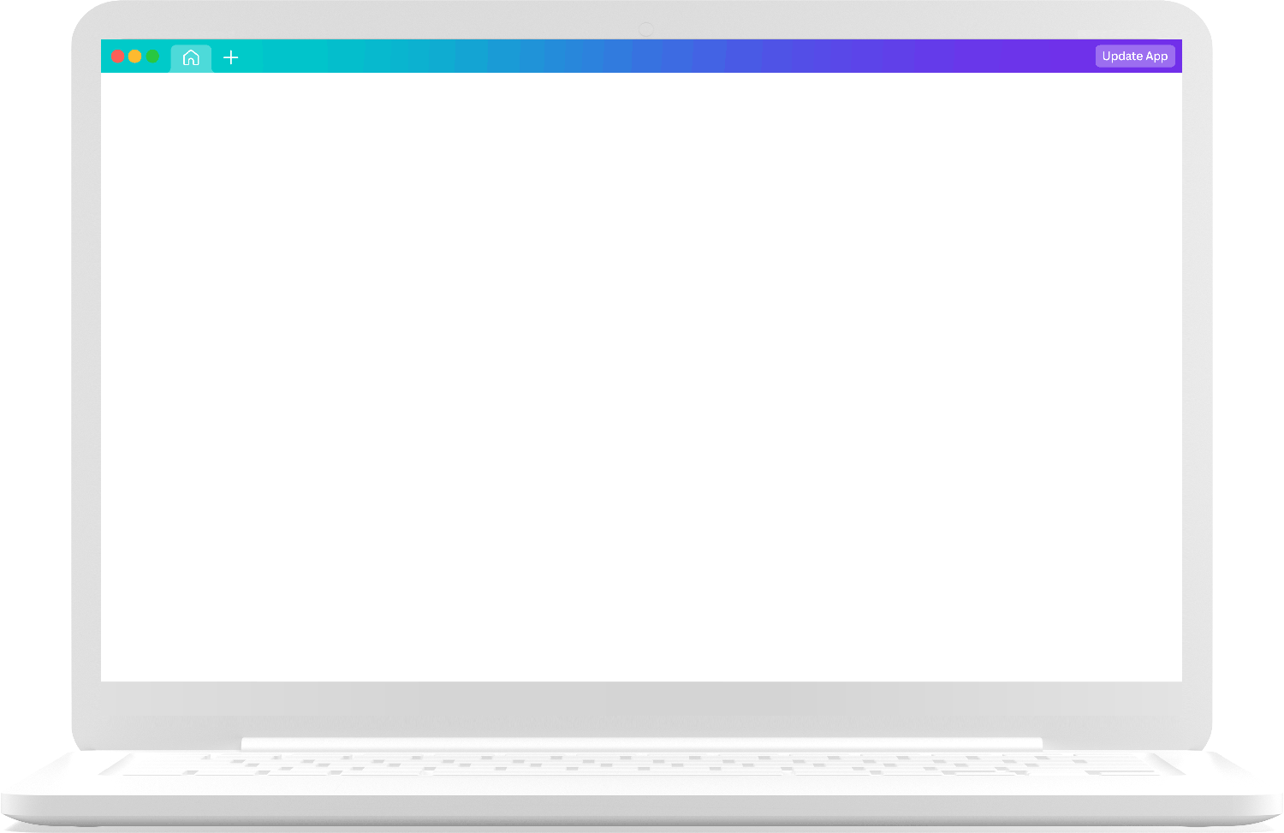
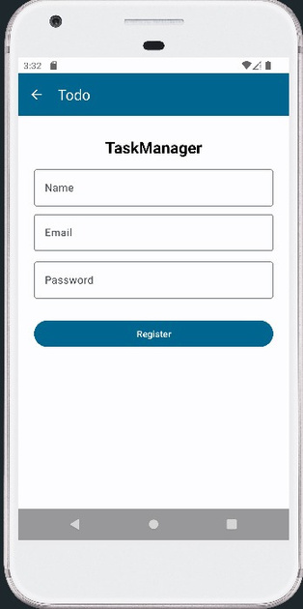
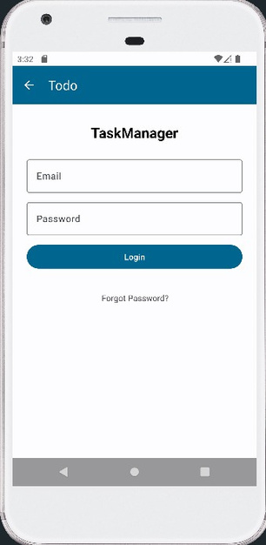
Image 1: New users can create an account by providing their email and password. Data is stored securely in Firebase.
Image 2: Users can securely sign in using their credentials. Firebase Authentication handles the backend logic for securely storing passwords.

Slide 7
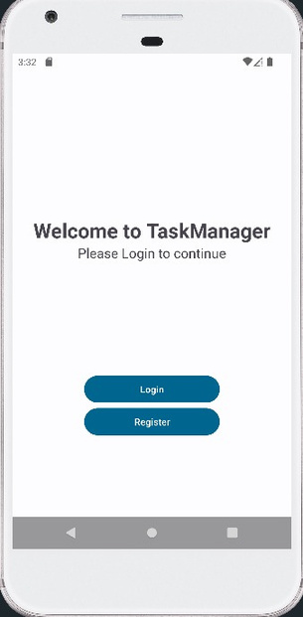
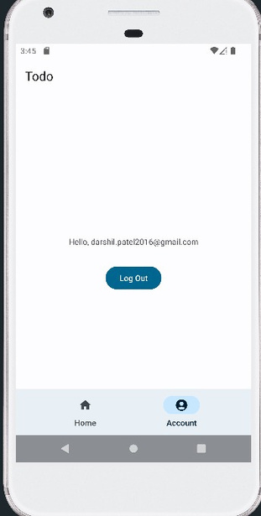
Image 1: The home page of the TaskManager app greets users with a clean, simple interface
Image 2: Users can view and update their profile, including changing their email or password.

Slide 8
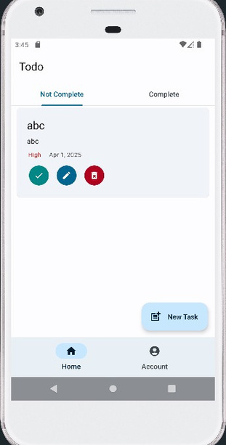
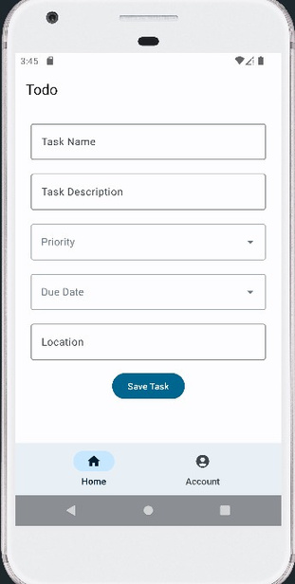
Image 1: A task can be marked as "completed," allowing users to track their progress.
Image 2: Users can update task details, such as changing the title, description, due date, or priority level.

Slide 9

Future Directions
Google Calendar Integration-
Description: Integrating with Google Calendar will allow users to automatically sync tasks with their calendar. This will provide a more organized way to view tasks alongside their scheduled events.
Benefits: Reduces manual entry of tasks, providing a unified view for users' schedules.
Schedule Reminder-
Description: Users can set scheduled reminders for tasks, which will notify them at a specific time (via local notifications).
Example Use Case: A user sets a reminder for a task to be completed by 6 PM. The app will notify them at 5:45 PM.
Email Reminder-
Description: In addition to push notifications, email reminders will ensure that users are notified about important tasks even if they are not using the app.
How It Works: The user will be sent an email at a scheduled time with details of the task.

Slide 10

Grading Rubric
Functionality (40%)-
Login & Register: Working authentication system and account management.
Task Management: Smooth functionality for adding, editing, deleting, and completing tasks.
Reminders: Working notification system for reminders based on due dates.
Code Quality (20%)-
Code Structure: Clean and organized code with separation of concerns (MVVM architecture).
Comments & Readability: Well-commented code explaining the logic where necessary.
Error Handling: Proper handling of edge cases such as missing data or incorrect inputs.

Slide 11
Grading Rubric
Design & Usability (20%)-
User Interface (UI): A clean, intuitive design that makes it easy for users to navigate and manage their tasks.
UX: Seamless user experience that minimizes clicks and ensures a simple flow for task management
Future Enhancements (20%)-
Plans: Clear plans for expanding the app in terms of functionality, such as adding iOS support, integrating with Google Calendar, and adding email reminders.
Innovation: Creative use of Firebase and Kotlin features to provide a smooth app experience.

Slide 12
Thank you very much!

